Slide 1
Memory Management
Chapter 7

Slide 2
Memory Management
Subdividing memory to accommodate multiple processes
Memory needs to be allocated efficiently to pack as many processes into memory as possible
should be able to run a program whose size is larger than the available real memory

Slide 3
Memory Management Requirements
Relocation
  Programmer does not know where the program will be placed in memory when it is executed
  While the program is executing, it may be swapped to disk and returned to main memory at a different location (relocated)
  Memory references in the code must be translated to actual physical memory addresses

Slide 4
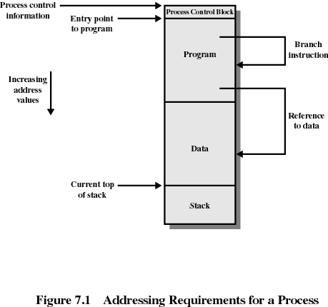

Slide 5
Memory Management Requirements
Protection
  Processes should not be able to reference memory locations in another process without permission
  Impossible to check absolute addresses in programs since the program could be relocated. Therefore,
  Must be checked during execution
    Operating system cannot anticipate all of the memory references a program will make
Sharing
  Allow several processes to access the same portion of memory
  Better to allow each process access to the same copy of the program (for read) rather than have their own separate copy

Slide 6
Fixed Partitioning
Main memory is divided into equal- (or unequal-) sized partitions and these partitions are assigned to processes.
Main memory use is inefficient. Any program, no matter how small, occupies an entire partition. This is called internal fragmentation.

Slide 7
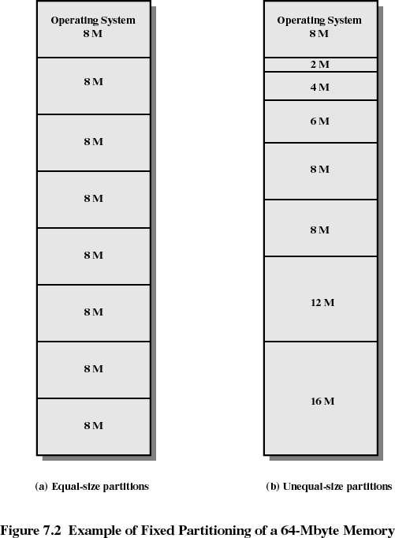

Slide 8
Placement Algorithm with Partitions
Equal-size partitions
  because all partitions are of equal size, it does not matter which partition is used
Unequal-size partitions
  can assign each process to the smallest partition within which it will fit
  queue for each partition or a single queue for all
  processes are assigned in such a way as to minimize wasted memory within a partition

Slide 9
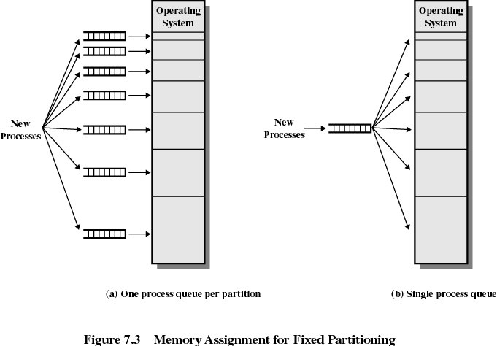

Slide 10
Dynamic Partitioning
Partitions are of variable length and number
Process is allocated exactly as much memory as required
Eventually get holes in the memory. This is called external fragmentation
Must use compaction to shift processes so they are contiguous and all free memory is in one block

Slide 11
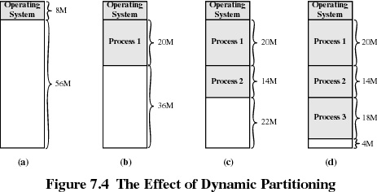

Slide 12
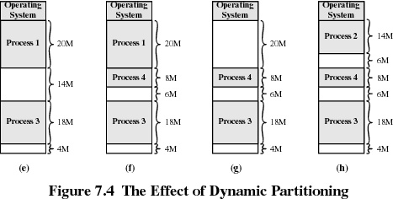

Slide 13
***here**Dynamic Partitioning
Placement Algorithms
Operating system must decide which free block to allocate to a process
Three popular strategies
  First-fit
  Best-fit
  Next-fit

Slide 14
Dynamic Partitioning
Placement Algorithms
First-fit algorithm
  Fastest
  May have many processes loaded in the front end of memory that must be searched over when trying to find a free block
Best-fit algorithm
  Chooses the block that is closest in size to the request
  Worst performer overall
  Since smallest block is found for process, the smallest amount of fragmentation is left. Memory compaction must be done more often

Slide 15
Placement Algorithms cont.
Next-fit
  More often allocate a block of memory at the end of memory where the largest block is found
  The largest block of memory is broken up into smaller blocks
  Compaction is required to obtain a large block at the end of memory

Slide 16
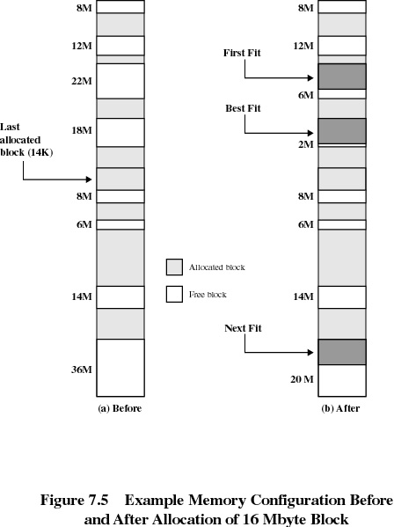

Slide 17
Buddy System
Entire space available is treated as a single block of 2^{U}
If a request of size s is such that 2^{U-1} < s ≤ 2^{U}, entire block of 2^{U} is allocated
  Otherwise block is split into two equal buddies
  Splitting continues until smallest block greater than or equal to s is generated

Slide 18
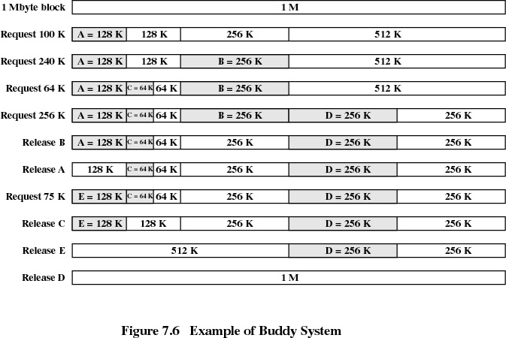

Slide 19
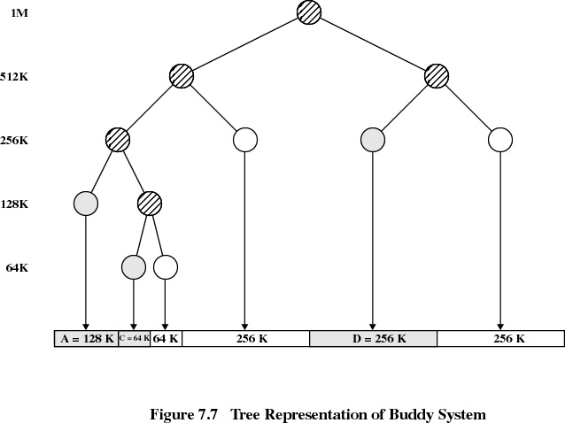

Slide 20
Paging
Partition memory into small equal-size chunks and divide each process into the same size chunks
The chunks of a process are called pages and chunks of memory are called frames
Operating system maintains a page table for each process
  contains the frame location for each page in the process
  each memory reference consist of a page number and offset within the page

Slide 21
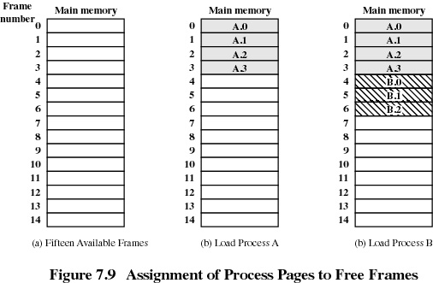

Slide 22
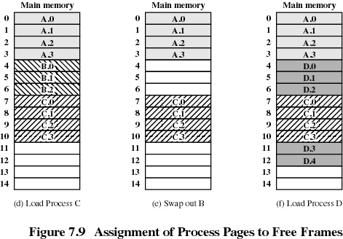

Slide 23
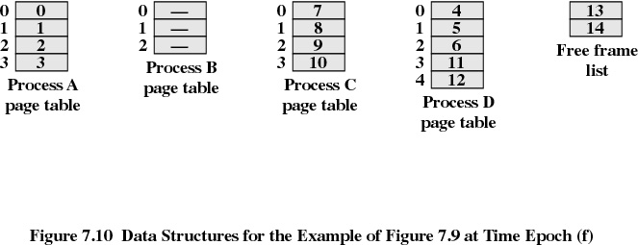
Page Tables are ….

